Slide 1
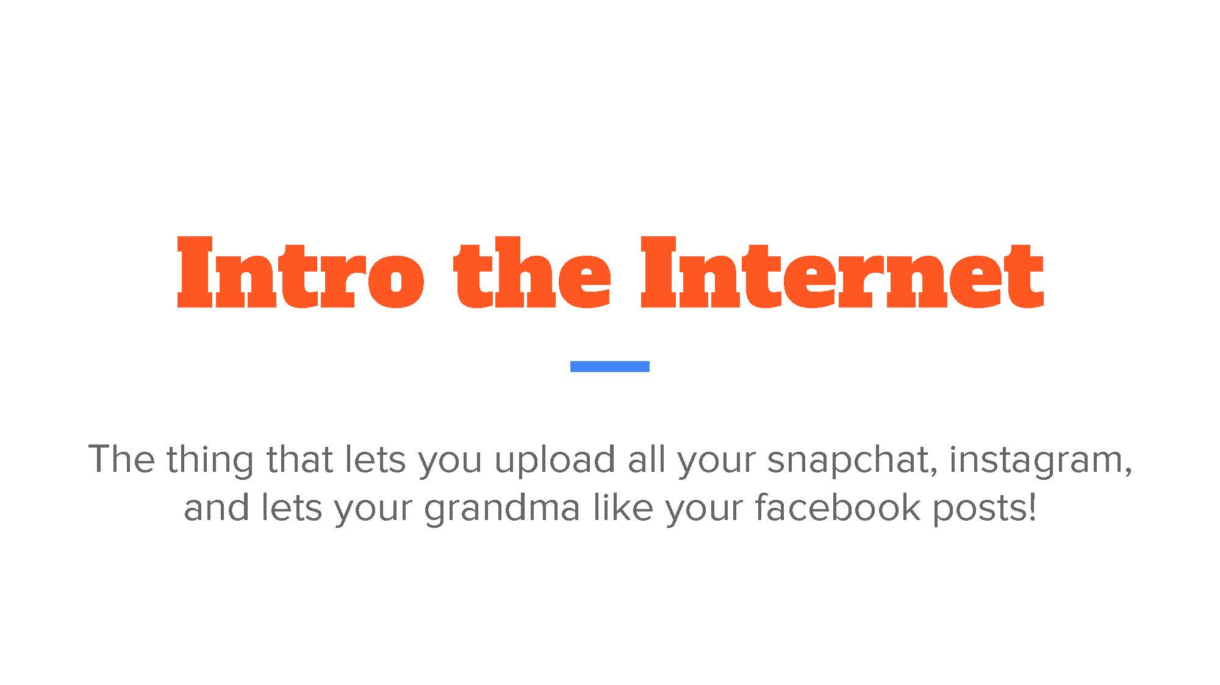

Slide 2


Slide 3
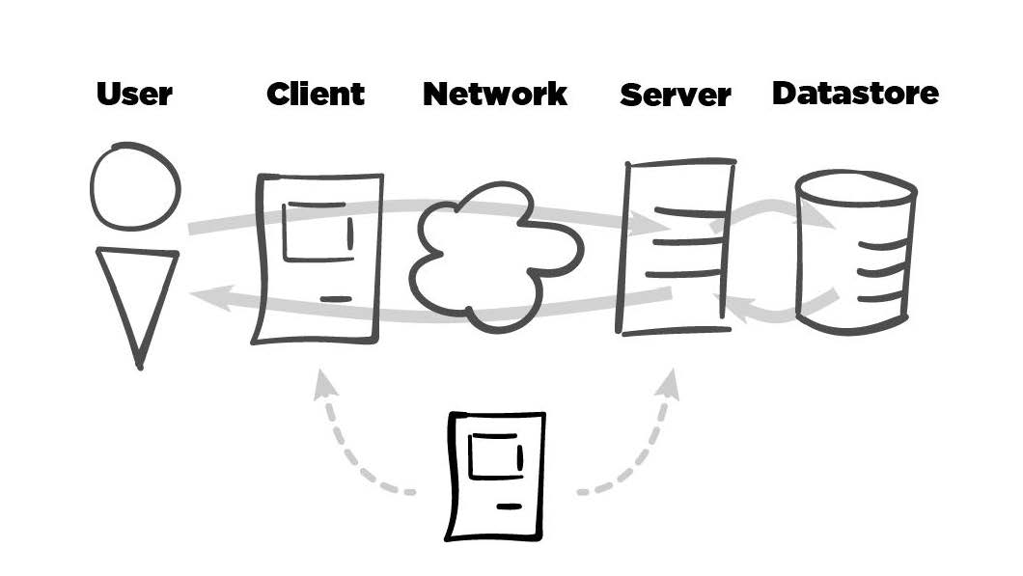

Slide 4


Slide 5


Slide 6
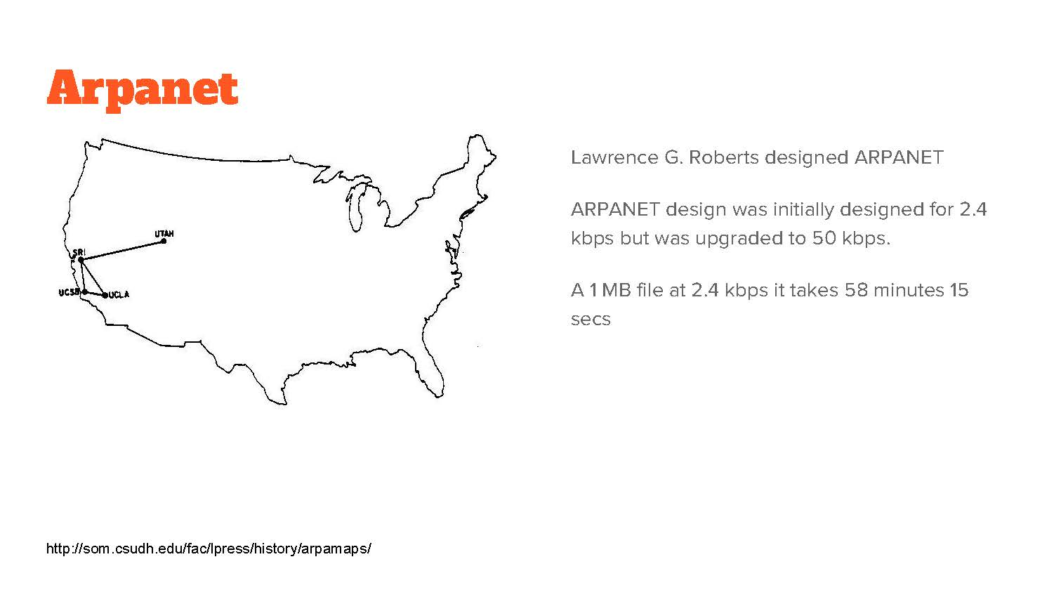

Slide 7
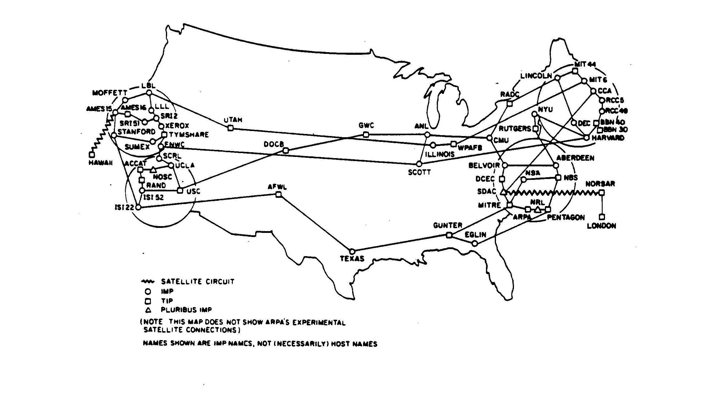

Slide 8
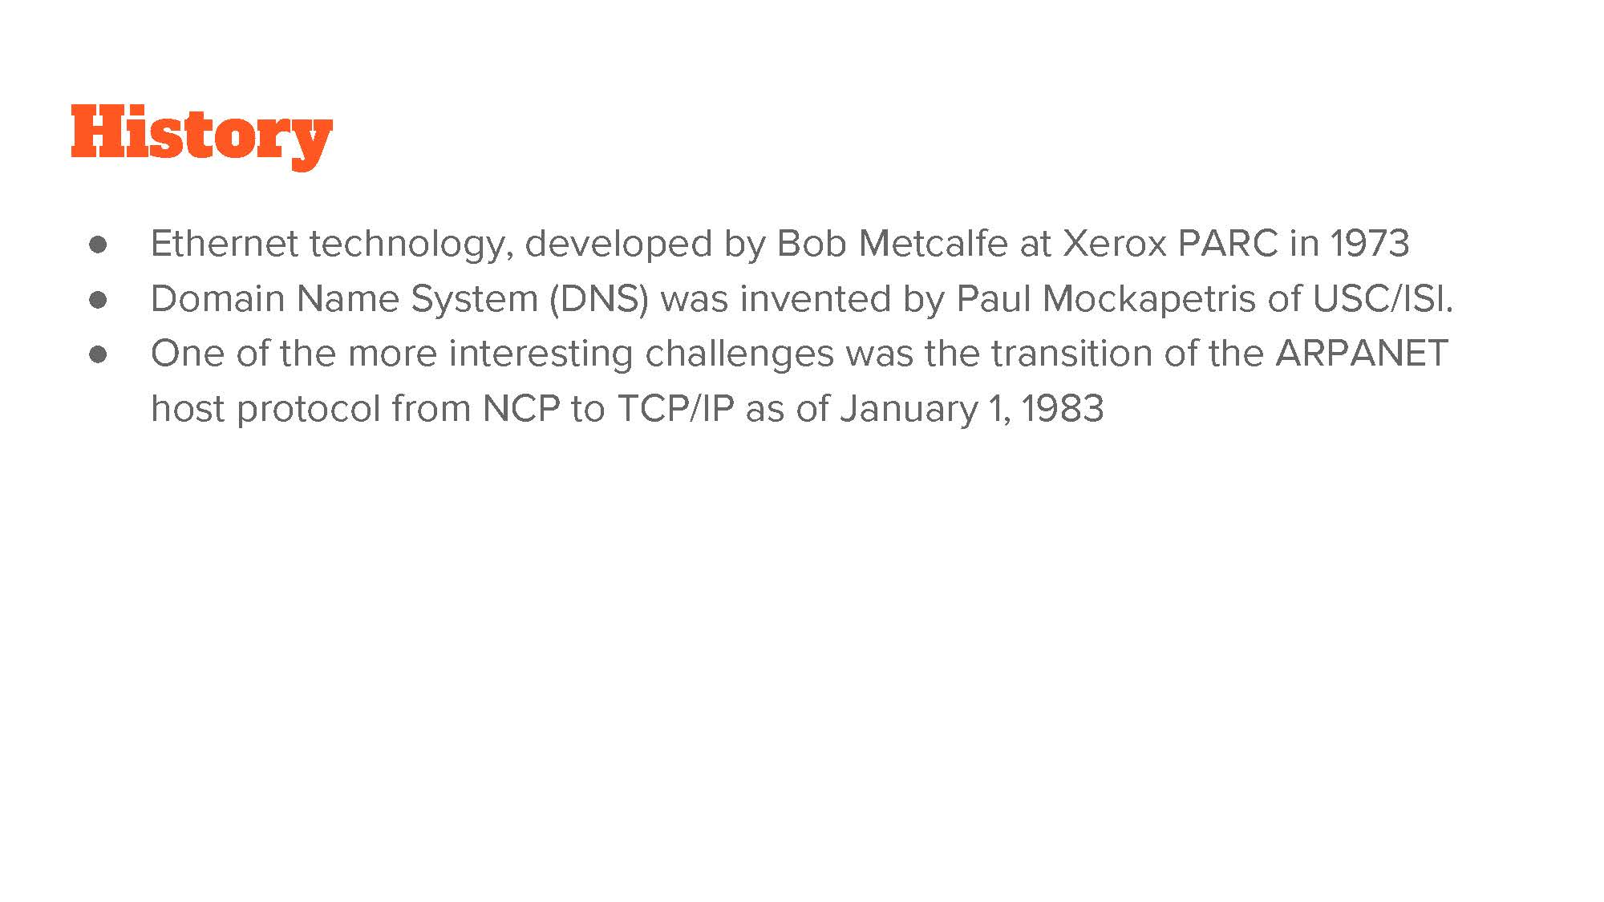

Slide 9
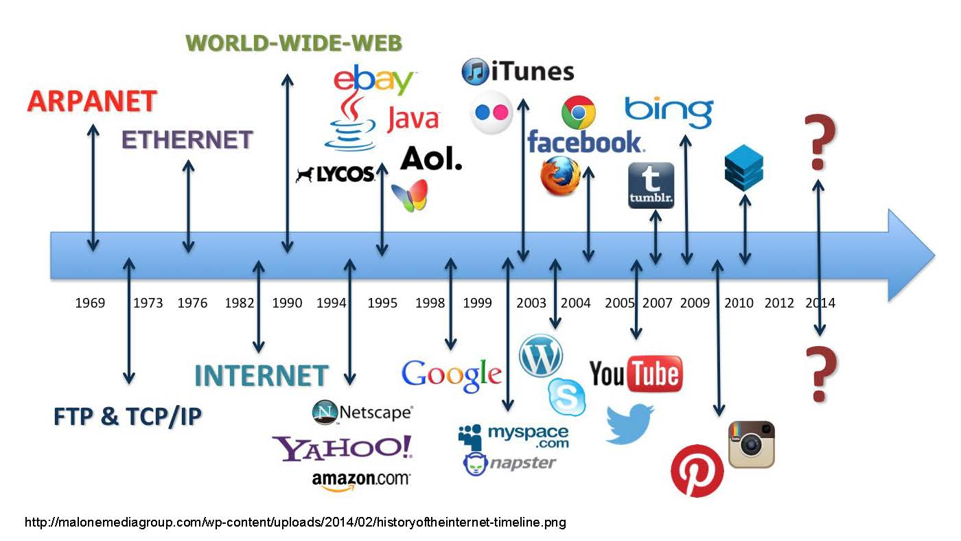

Slide 10


Slide 11
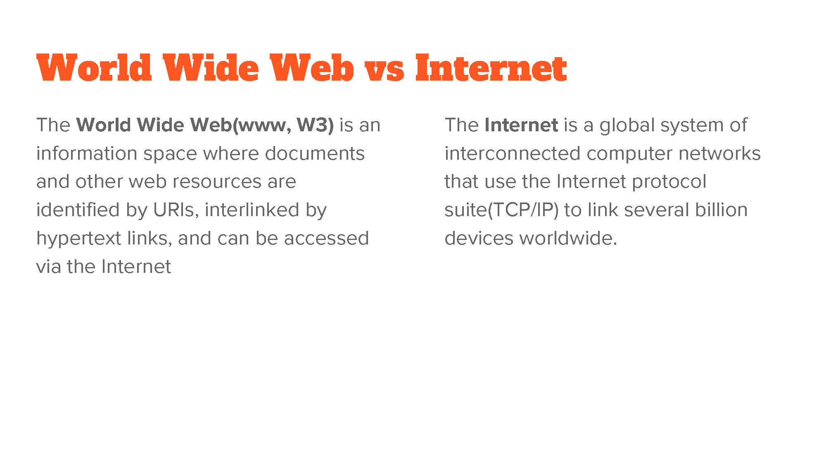

Slide 12
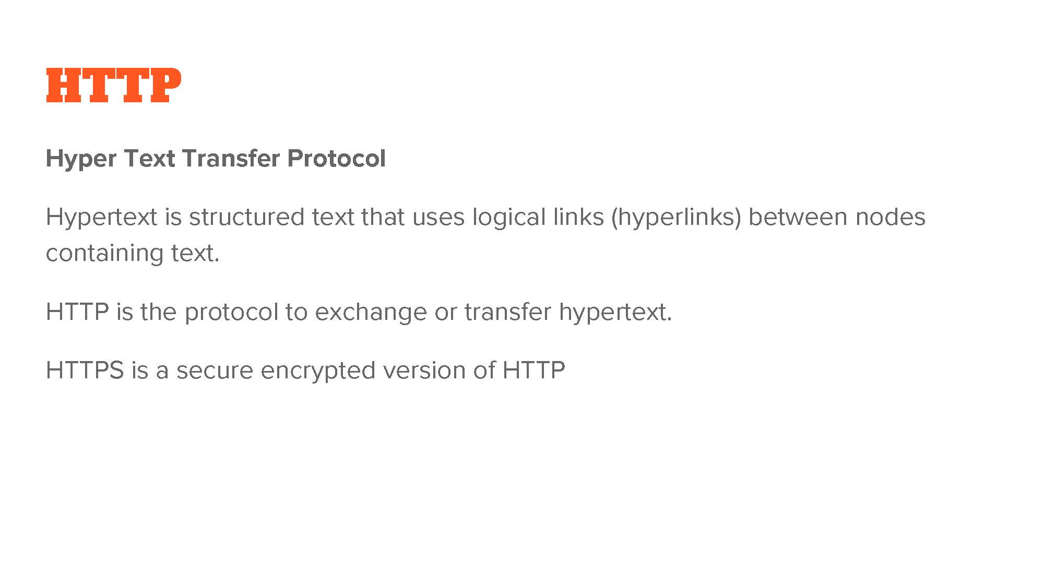

Slide 13
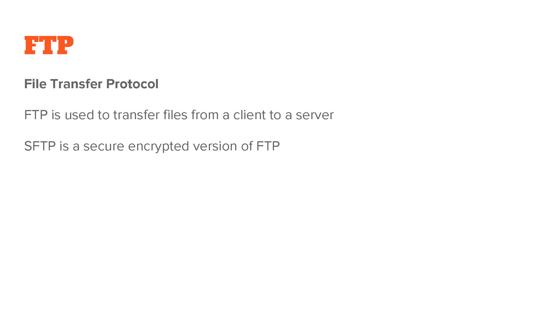

Slide 14
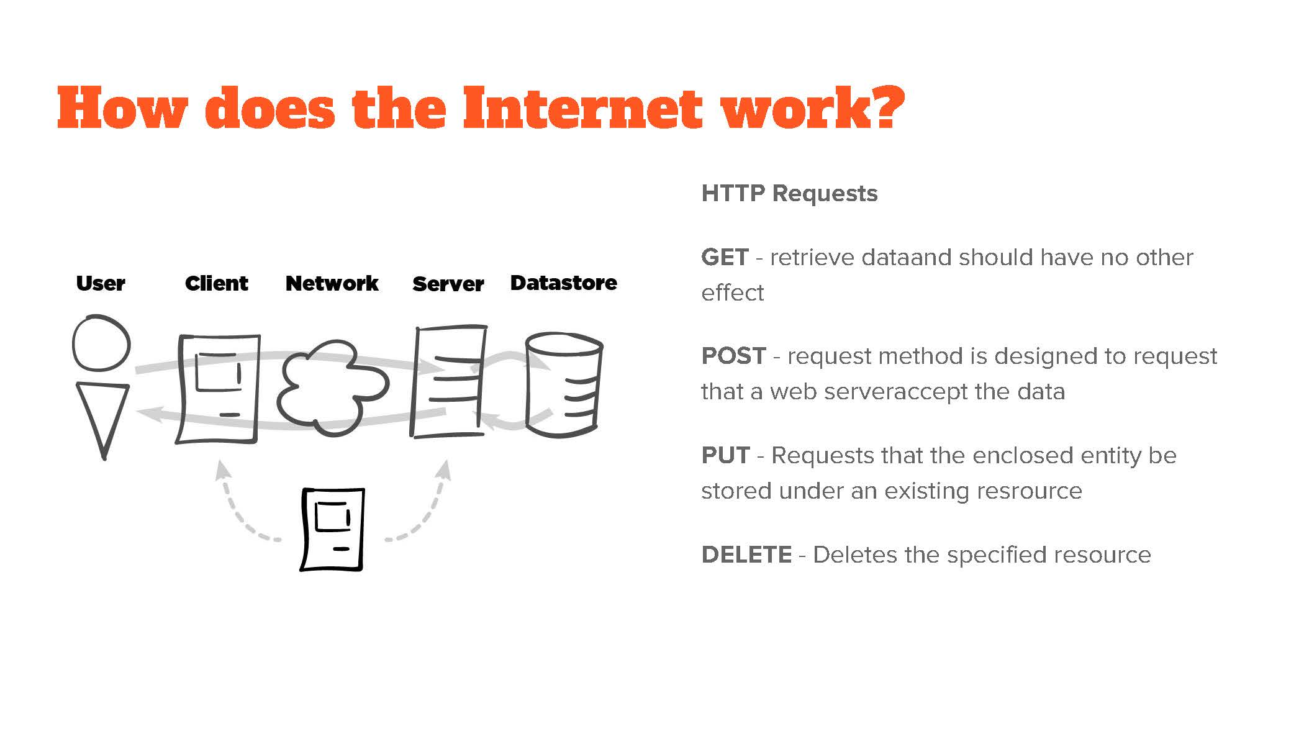

Slide 15
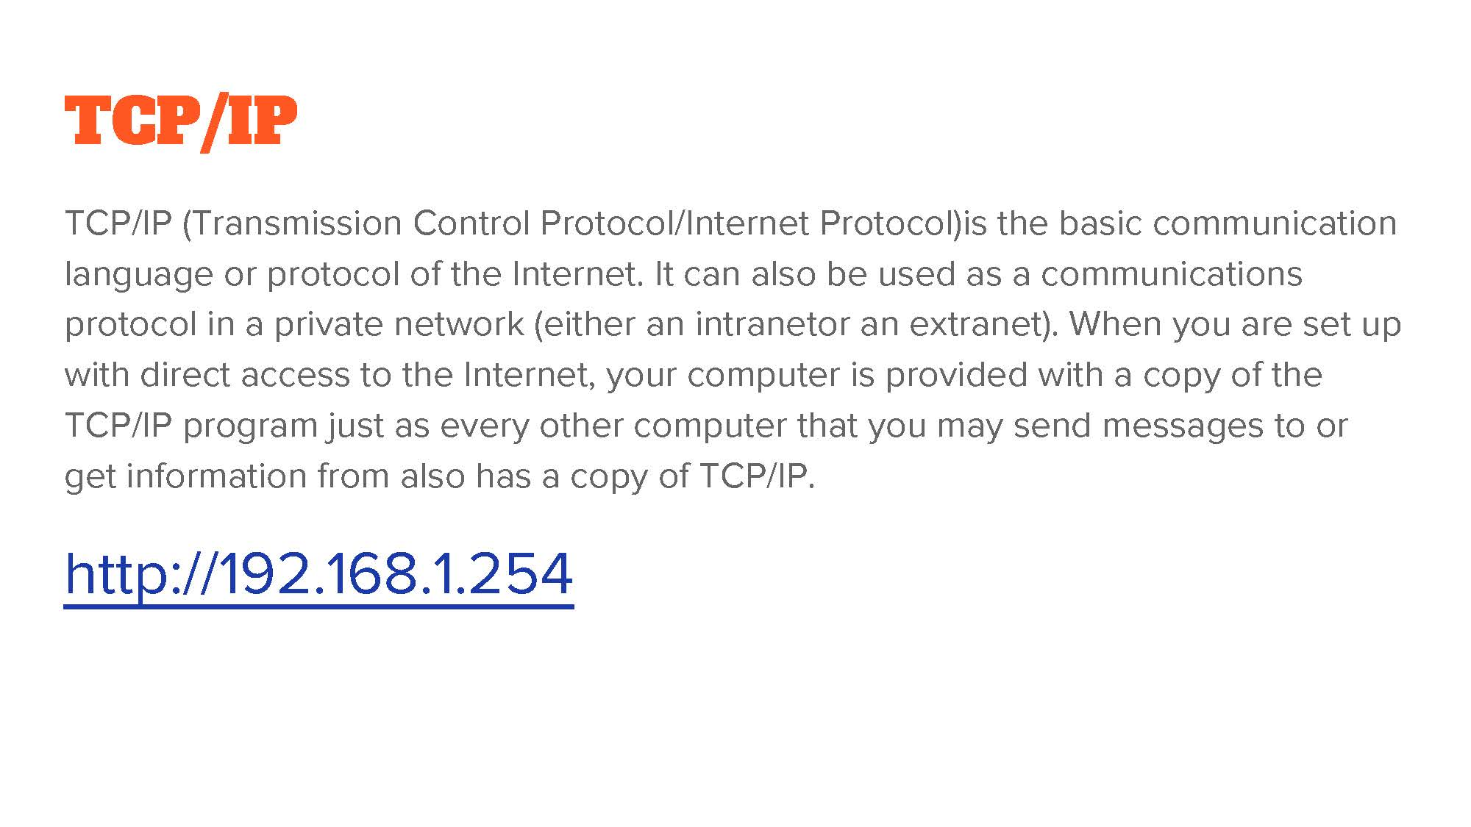

Slide 16
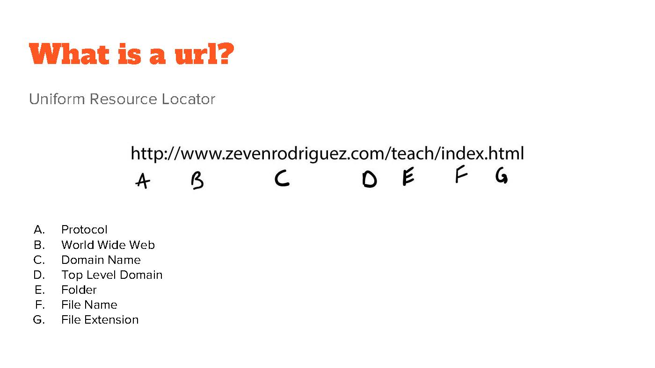

Slide 17


Slide 18
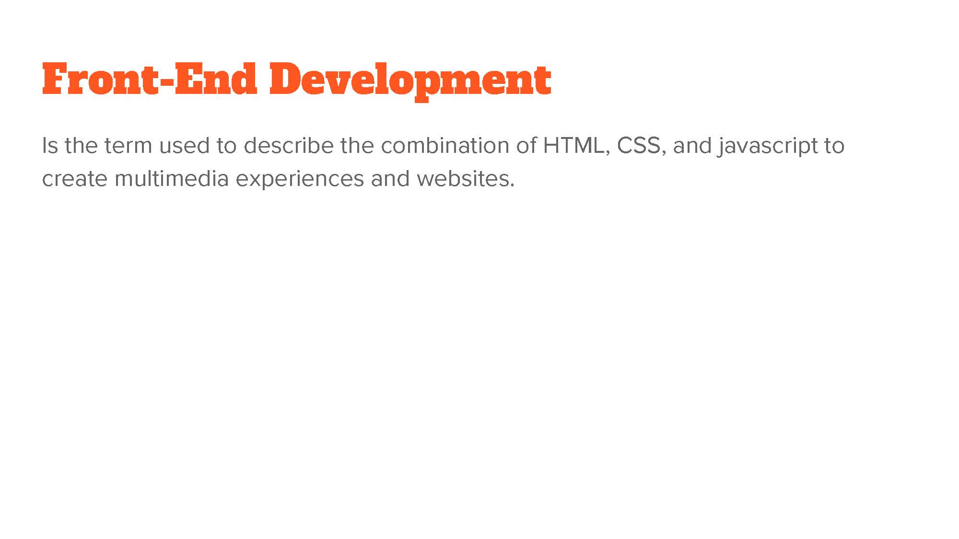

Slide 19
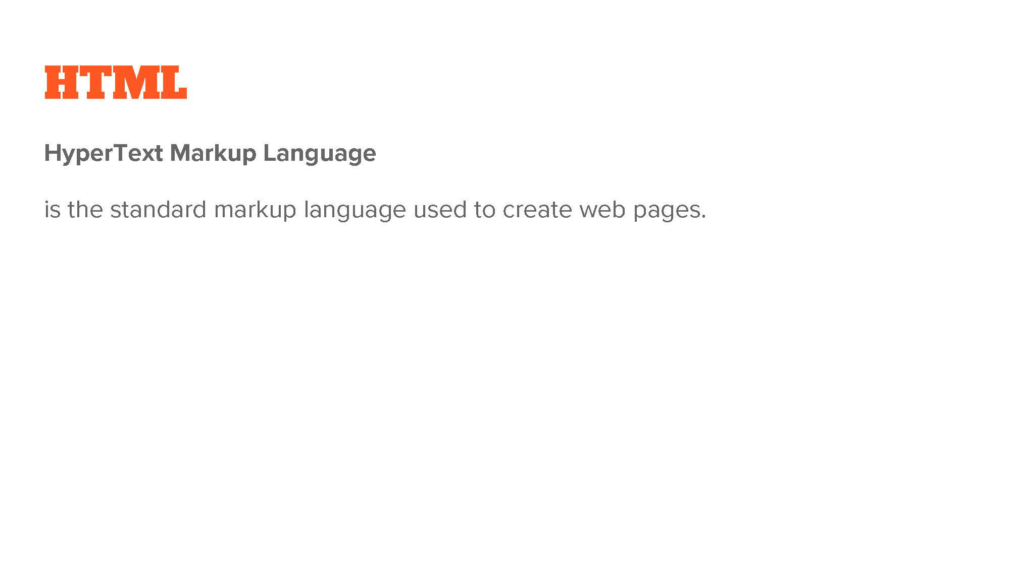

Slide 20
First-Ever Website went live August 6, 1991
Created by: Tim Berners-Lee
Tim is attributed the creator of the first Web Browser and the World Wide Web.
http://info.cern.ch/hypertext/WWW/TheProject.html.

Slide 21


Slide 22
CSS Zen Garden
Demonstrates what can be accomplished through CSS-based design.
http://www.csszengarden.com/

Slide 23
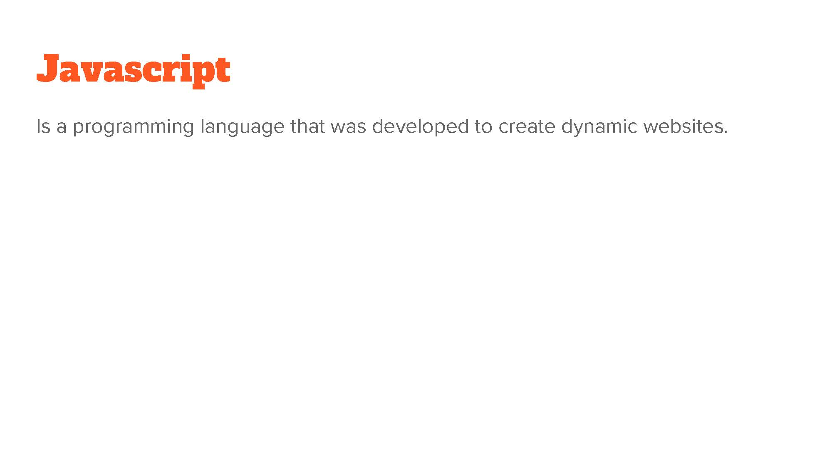

Slide 24
JS Textbook Resources for Free
One of many free resources online for people learning Javascript.
https://eloquentjavascript.net/
You don’t know JS (More advanced topics)
https://github.com/getify/You-Dont-Know-JS
And for those of you who can’t get enough:
https://jsbooks.revolunet.com/

Slide 25
Mapping the Internet
The Internet
https://www.submarinecablemap.com/#/
https://maps.esri.com/rc/sat2/index.html
Internet of Things
https://venturescannerinsights.files.wordpress.com/2015/04/iot-visual-map.jpg
Mapping the World Wide Web
http://internet-map.net/
http://orig02.deviantart.net/fe72/f/2014/030/7/9/map_of_the_internet_1_0__by_the9988-d72b5tb.jpg

Slide 26


Slide 27
U.S. Bureau of Labor Statistics
Between 2016 – 2026 The Department of Labor projects a 15% increase in Web Development Jobs across several industries.
https://www.bls.gov/ooh/computer-and-information-technology/web-developers.htm#tab-6

Slide 28
The Minimum 3 – 5 years
Experience! Conundrum

Slide 29
Web Development Jobs
Jobs are Portfolio driven
Jobs are project based or Full-time
Jobs are remote work friendly
Make your own job/company

Slide 30
Places to Apply

Slide 31
Job Search
Use the right keywords
Frontend Wireframe SEO
Web Developer User Experience Google Analytics
Web Engineer User Research
HTML Web Design
CSS Github
JS Git
Jquery Slack

Slide 32
Steps to getting a job
Build Portfolio
Do Freelance Projects
Put your code on Github
Contribute to an Open Source Project
Participate in Hackathons
Meet other Techies (Meetup.com)
Follow Industry News
KEEP LEARNING ALWAYS!!!!
Refine Your Resume
Repeat

Slide 33
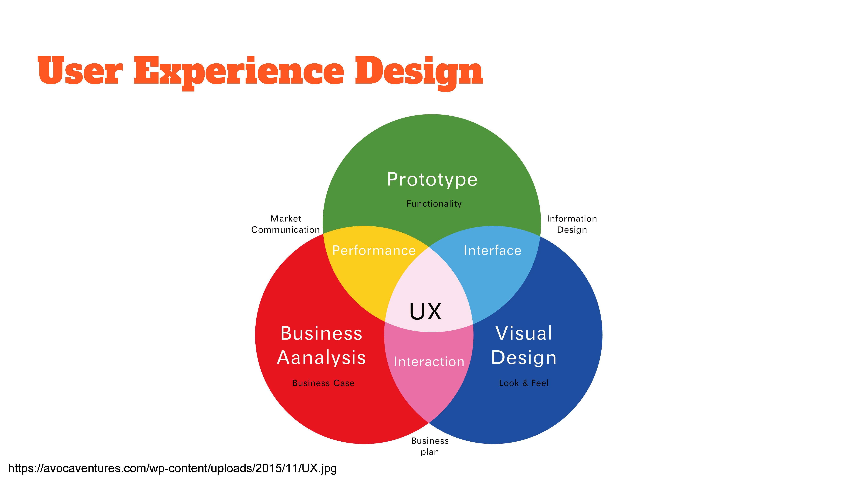

Slide 34


